Slide 1

CSE 1110
Introduction to Computer System
(Class VII)

Slide 2
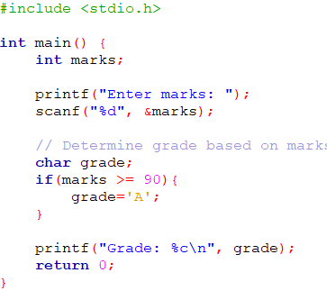

Problem 1: Grade Calculation Based on Marks Input
Code
Output
Will there be only one grade?

Slide 3
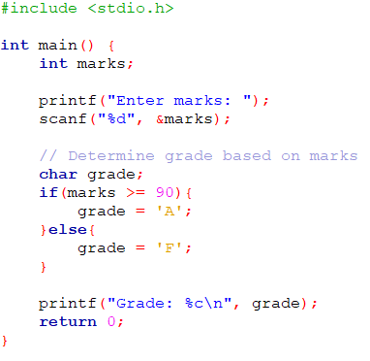

Problem 2: Grade Calculation Based on Marks Input
Code
Output
Will there be only two grades?

Slide 4
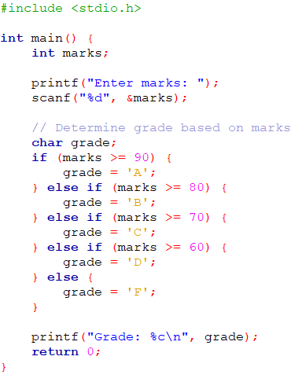

Problem 3: Grade Calculation Based on Marks Input
Code
Output
Wait….
What is this?
if, if-else, if-else if-else

Slide 5
Conditional Statement

Slide 6
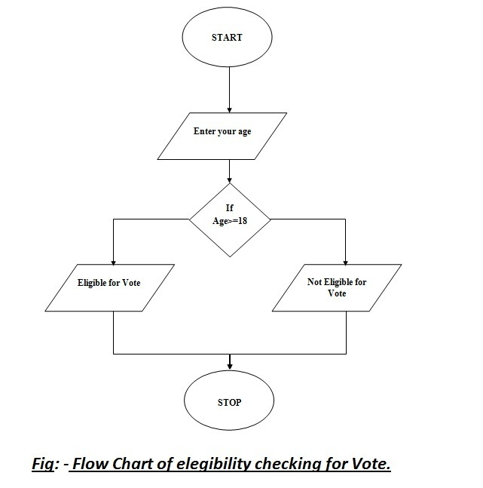
What is conditional statement?
Allows the code to make decisions based on certain conditions.
What is condition?
A condition in programming is a logical expression that evaluates to either true or false using operators
What is Operators?
==, >, <,&&, ||, !
For example, in the flowchart age >= 18, the program checks if the value of age is greater than or equal to 18. If it is, the condition is true; otherwise, it is false.

Slide 7
Operators
Relational Operators:
== (equal to): Checks if two values are equal.
> (greater than): Checks if the left value is greater than the right value.
< (less than): Checks if the left value is less than the right value.
Logical Operators:
&& (logical AND): Returns true if both conditions are true.
|| (logical OR): Returns true if at least one condition is true.
! (logical NOT): Inverts the truth value of a condition (true becomes false).
Some other relational operators:
>=
<=
!=
=<
=<
=>
=>
=!
Can you do this?
=!

Slide 8
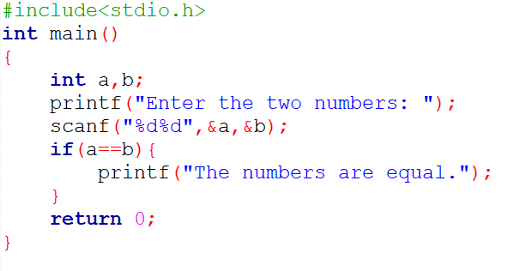
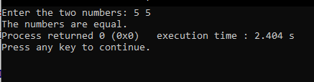
Problem 1: == (Equal To)
Write a program that checks if two numbers entered by the user are equal
Code
Output
What if the number are not equals?

Slide 9
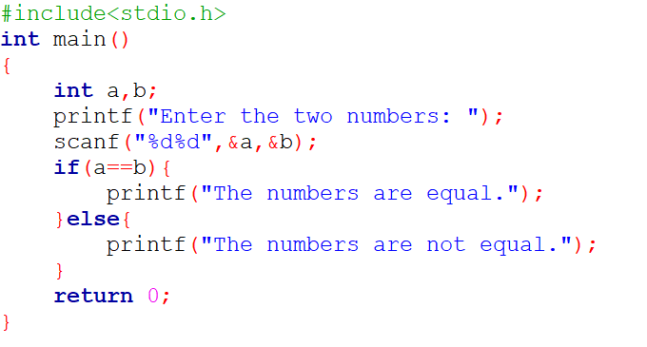


Problem 1.1: == (Equal To)
Write a program that checks if two numbers entered by the user are equal
Code
Output

Slide 10
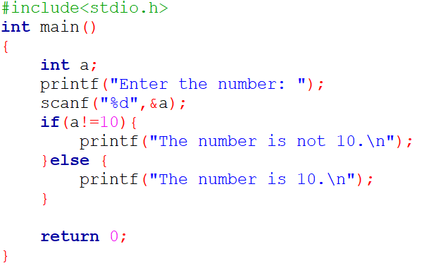

Problem 2: != (Not Equal To)
Write a program that checks if a user-entered number is not equal to 10.
Code
Output
Can you do this problem with ‘==’?

Slide 11
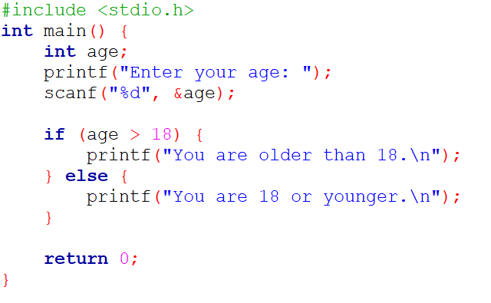
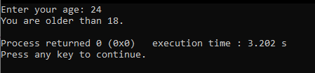
Problem 3: > (Greater Than)
Write a program that checks if a user-entered age is greater than 18.
Code
Output
What if we used ‘<’ instead of ‘>’?
What will be the output then for the same input?

Slide 12
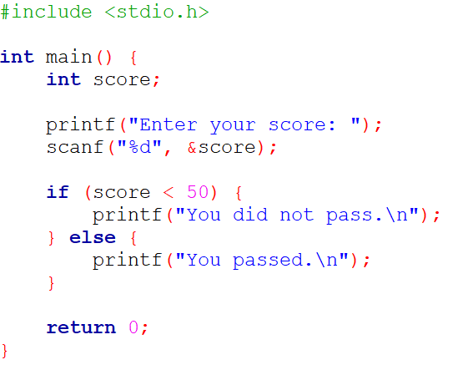
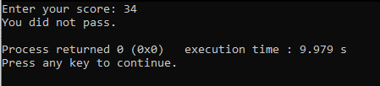
Problem 4: < (Less Than)
Write a program that checks if a student's score is less than the passing mark of 50.
Code
Output
Can you do this problem with ‘>’?
What will be the output if the user inputs 54?
What if you score 50?

Slide 13
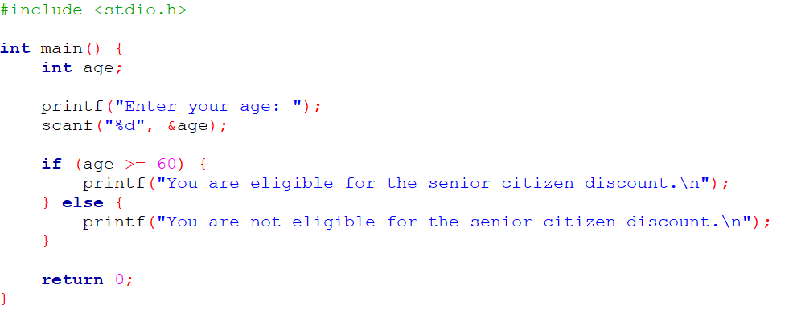

Problem 5: >= (Greater Than or Equal To)
Write a program that checks if a person is eligible for a senior citizen discount, which is given to people aged 60 or above.
Code
Output

Slide 14
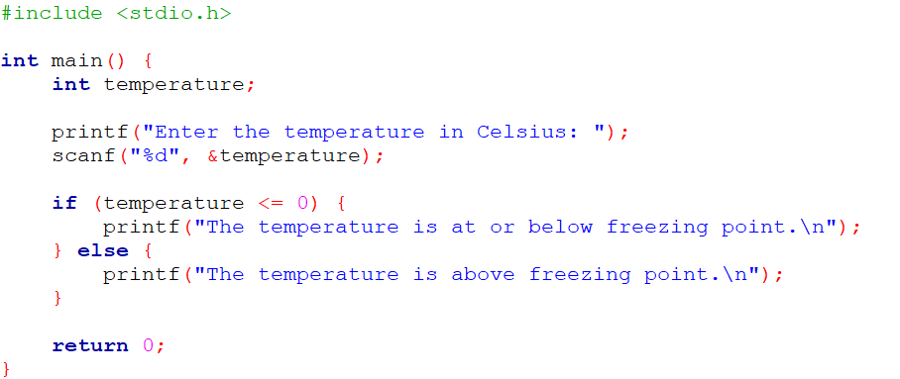

Problem 6: <= (Less Than or Equal To)
Write a program that checks if a temperature is below freezing point or exactly at it (0°C).
Code
Output

Slide 15
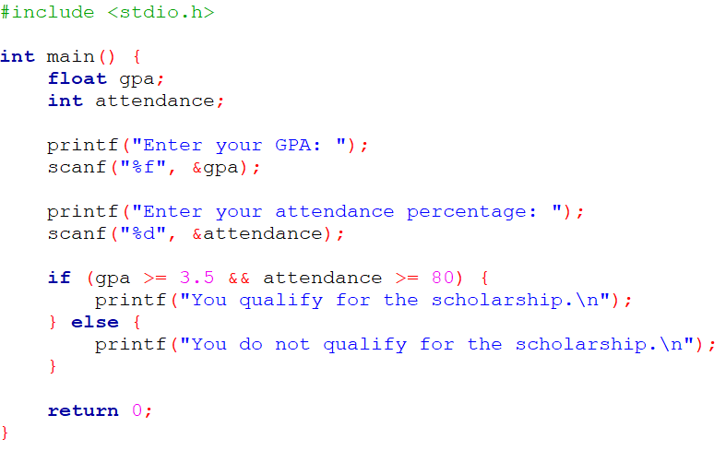
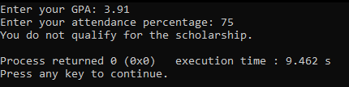
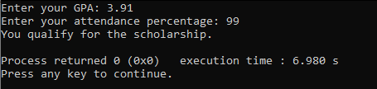
Problem 7: && (Logical AND)
Write a program that checks if a student qualifies for a scholarship by having a GPA of 3.5 or higher and a minimum of 80% attendance.
Code
Output

Slide 16
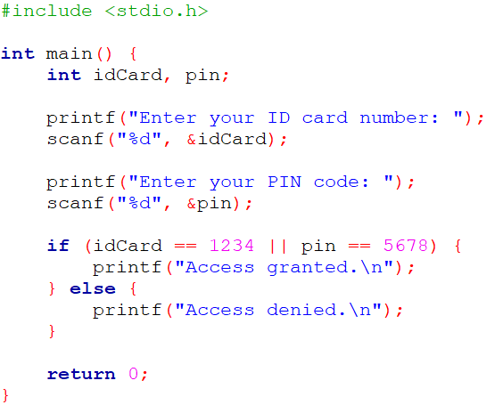
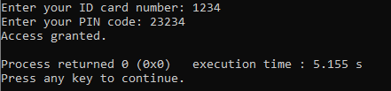
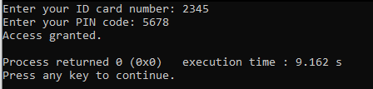
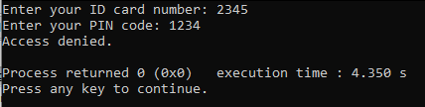
Problem 8: || (Logical OR)
Write a program that checks if a user can enter a building using either their ID card or a PIN code (you can assume the ID card is a specific number and the PIN is another number).
Code
Output

Slide 17
Any Questions?

Slide 18
Thank you

